Slide 1


London
ACROSS CULTURES

Slide 2
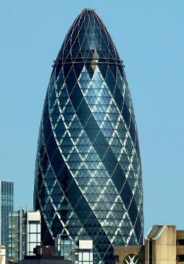
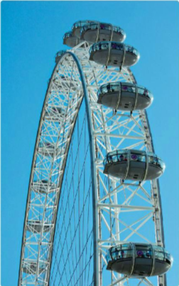
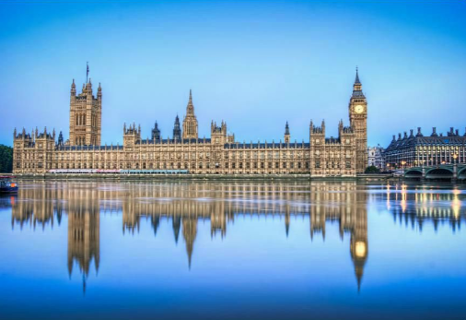
What is the capital city of the UK?
What do you know about London?
Are there any famous landmarks you would like to visit?
Which? Why? Talk to your partner and share.
Can you recognize the three landmarks in the photos?
Use the Internet and try to find out their names.

Slide 3
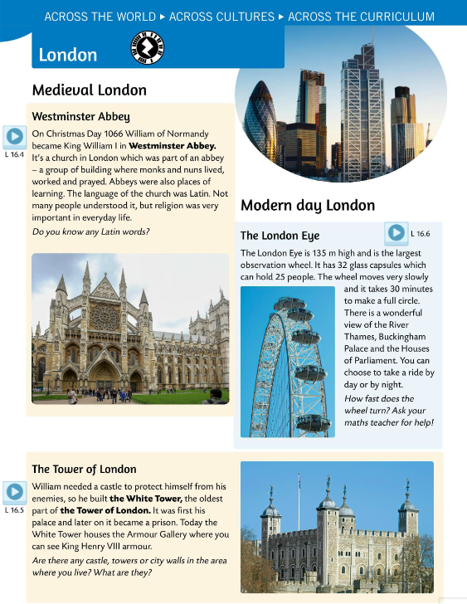
VOCABULARY BOX
an abbey – opatija, samostan
a monk – redovnik
a nun – redovnica, časna sestra
to pray - moliti
Latin – latinski jezik
an armour – oklop
a palace – palača
an observation wheel – panoramski kotač
a wonderful view – prekrasan pogled
to take a ride – provozati se
a high-rise building - neboder
to save energy – štedjeti energiju
a heating and cooling system – sustav grijanja i hlađenja

Slide 4
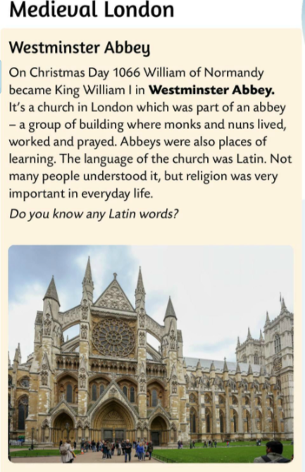

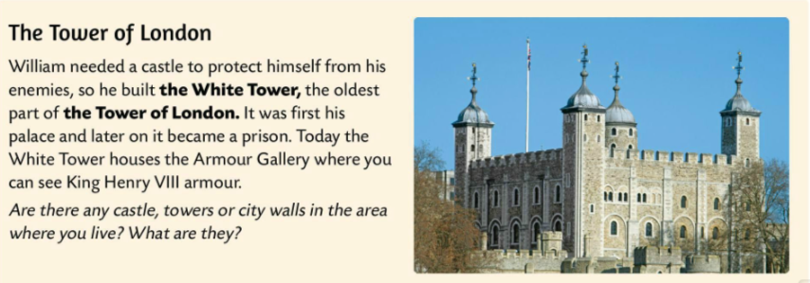
Listen and read.
Listen about Wesminster Abbey.
Listen about the Tower of London.
Are there any castles, towers or city walls in the area where you live? What are they?
Use the Internet to find out. Work in pairs.

Slide 5
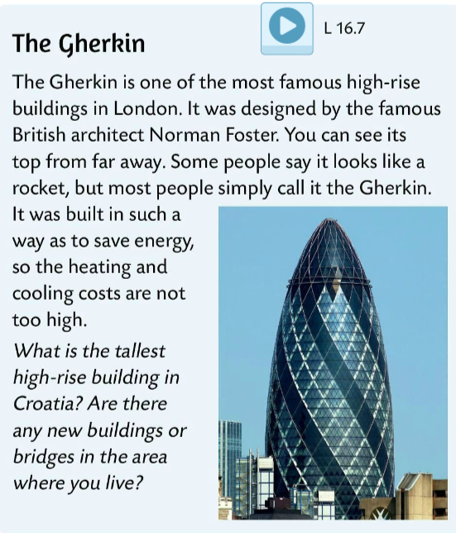
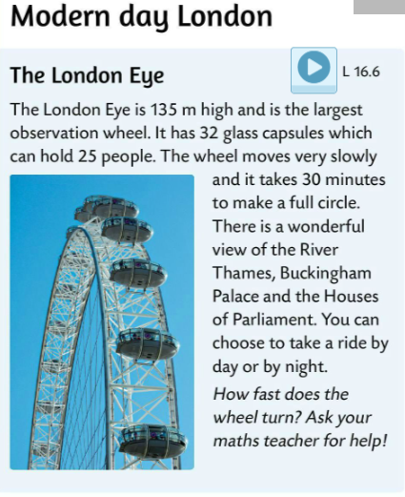
Listen about the London Eye. It’s the famous modern landmark.
Are there any new buildings or bridges in the area where you live?
Listen about the most famous high-rise building in London. It’s called the Gherkin.

Slide 6
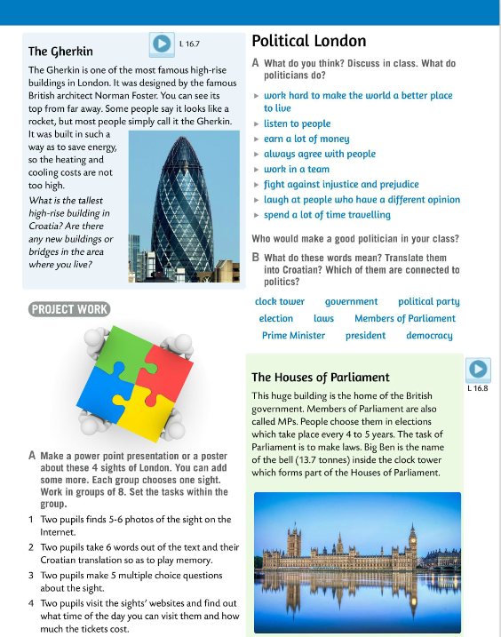
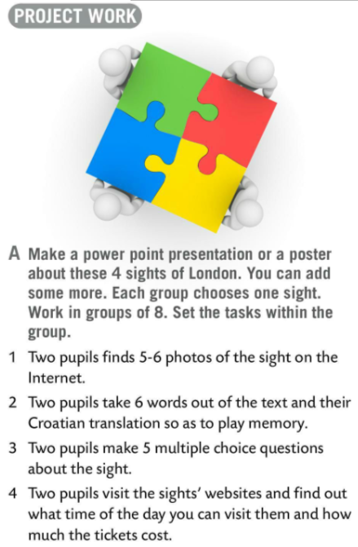
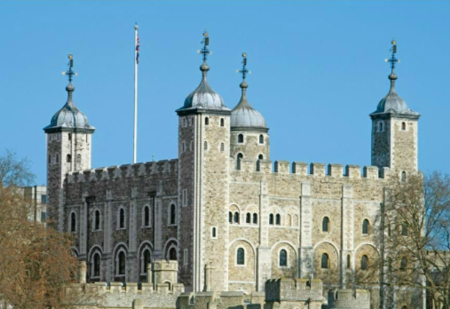
PROJECT WORK
Make a presentation or a poster about these four sights of London. You can add some more. Each group chooses one sight.
Work in groups of 8. Set the tasks within the group. Follow the advice in your book in Tak A.
Present your work.

Slide 7
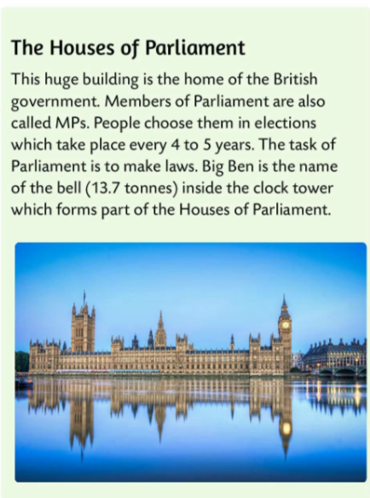
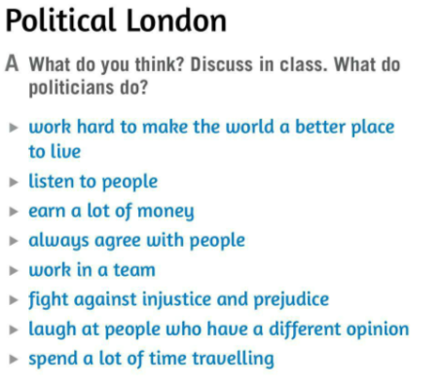
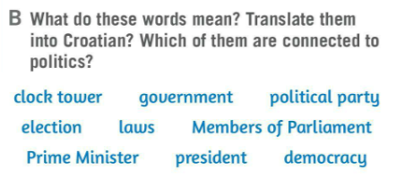
What do you think politicians do? Discuss in class sentences from Task A.
Who would make a good politician in your class? Why?
Translate the words in Task B. Write in your notebook.
Which of them are connected to politics?
vlada
politička stranka
zvonik, toranj sa satom
izbori
zakon
članovi parlamenta
premijer, predsjednik vlade
predsjednik
demokracija
Check.
Listen to the recording and then read the text about another famous London sight.

Slide 8
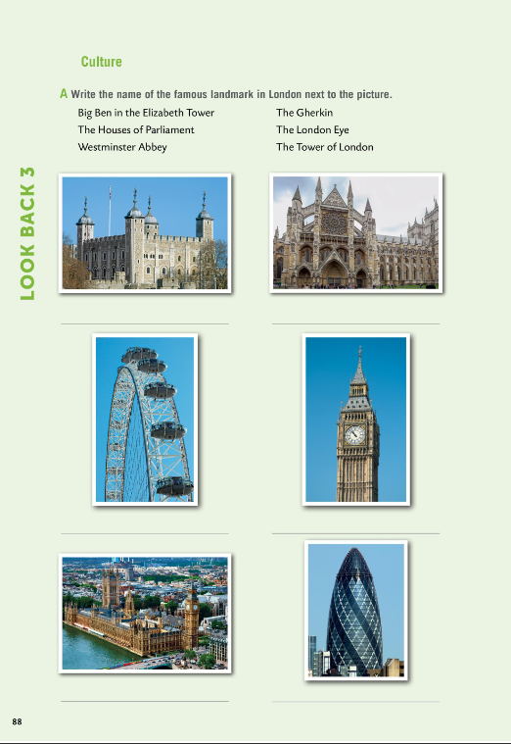
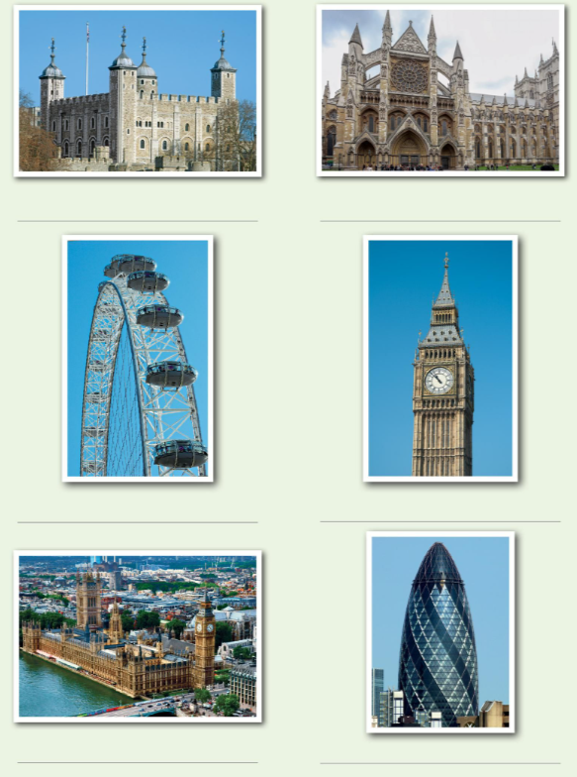
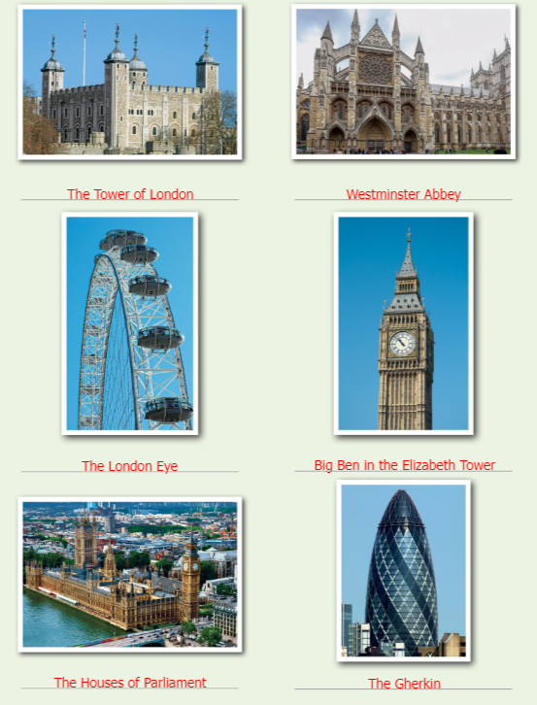

Workbook, page 88.
Do Task A.
Check.
Play a game. https://wordwall.net/play/10192/645/634

Slide 9
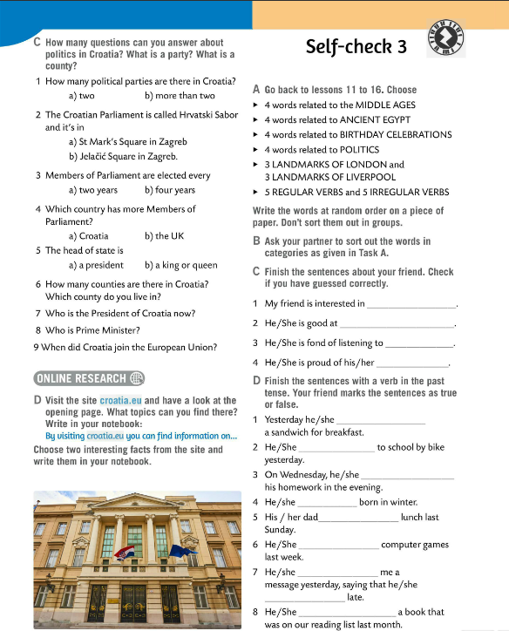
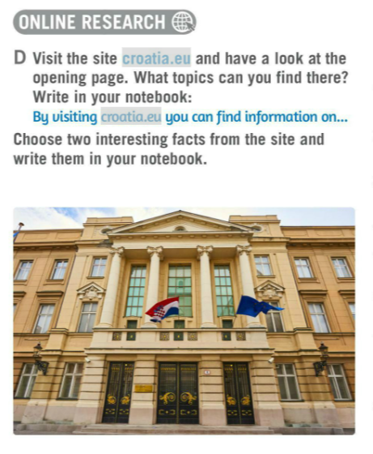
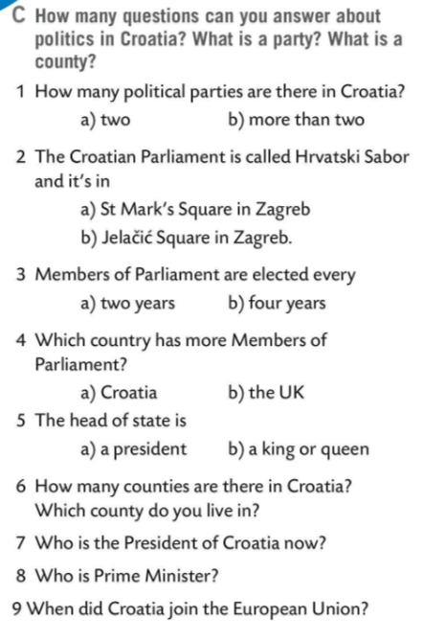
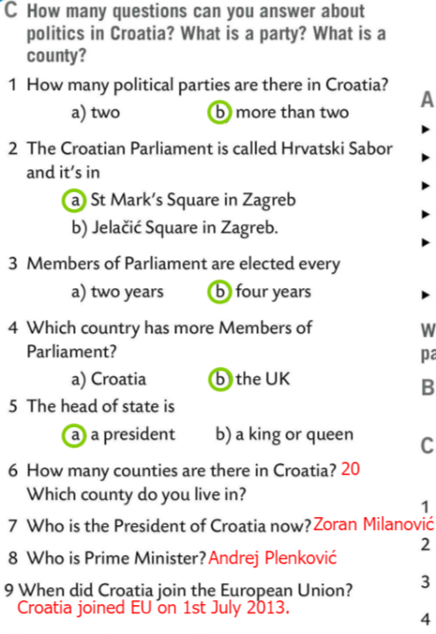
Do Task C. How many questions can you answer about politics in Croatia What is a party? What is a county?
Check.
Visit the site croatia.eu and have a look at the opening page. What topics can you find there? Write in your notebook:
By visiting croatia.eu you can find information on…
Choose two interesting facts from the site and write them in your notebook.

Slide 10
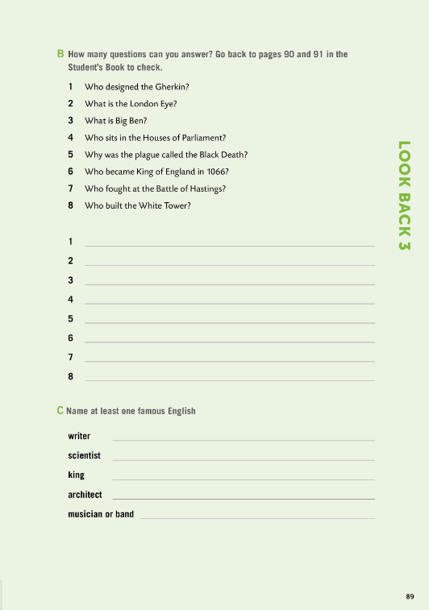
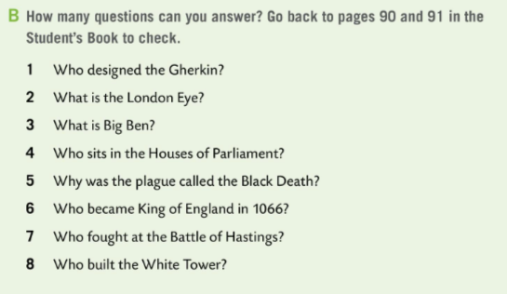
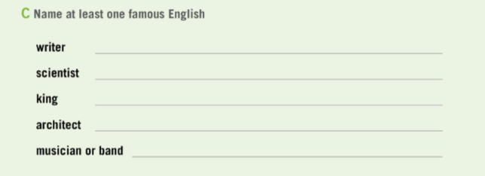
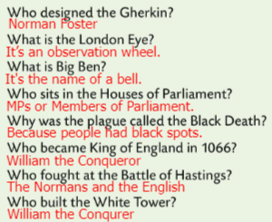
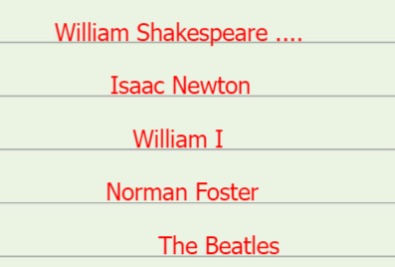
Workbook, page 89.
How many questions can you answer in Task B? Go back to pages 90 and 91 in the Student’s Book to check.
Check.
Name at least one famous Englishman/Englishwoman in Task C.
Check.

